Slide 1
7225 N. Greenview Community Meeting

Slide 2
Project Information
Project Team
Owner: Kristen Huffman-Gottschling, PhD, LCSW, P.A.C.T.T. Learning Center
Attorney: Andrew Scott, Dykema Gossett PPLC
Architect: George Beach AIA, B3 Architecture
Contractor: Michael Damato, Bulley & Andrews
Zoning Information
The building has been used as a convent and monastery, categorized in the Chicago Zoning Code as Residential, B. Group Living 2. Convents and Monasteries.
Building proposed zoning use group K. School
We are asking for a Zoning change from RT4 to RM4.5.
Lot Area 8,250 SF
Existing Building Footprint 3,367 SF/ Prosed Elevator & Accessible Lobby 161 SF (Existing FAR 1.04/ Proposed FAR 1.06)
Parking determination requirements: 10 off-street parking, 8 on-site bicycle spaces, and 2 loading/ drop-off spaces on Chase Ave.
We are providing a 5-stop elevator & accessible entry lobby at grade. (The new elevator conflicts with building setbacks.)
45% of the building will be renovated into new learning environments (including accessible toilet rooms) . The Existing building is 11,854 SF, and the Renovation is 5,385 SF.
3 Existing Noncompliant Parking Spaces/ Provide 1 Accessible Parking Space Provided on Site
Zoning Relief
9 Parking Spaces
Side & Rear Setbacks to accommodate ADA Entrance and Elevator.
2 Drop-off/ Loading Spaces on Chase Ave.

Slide 3
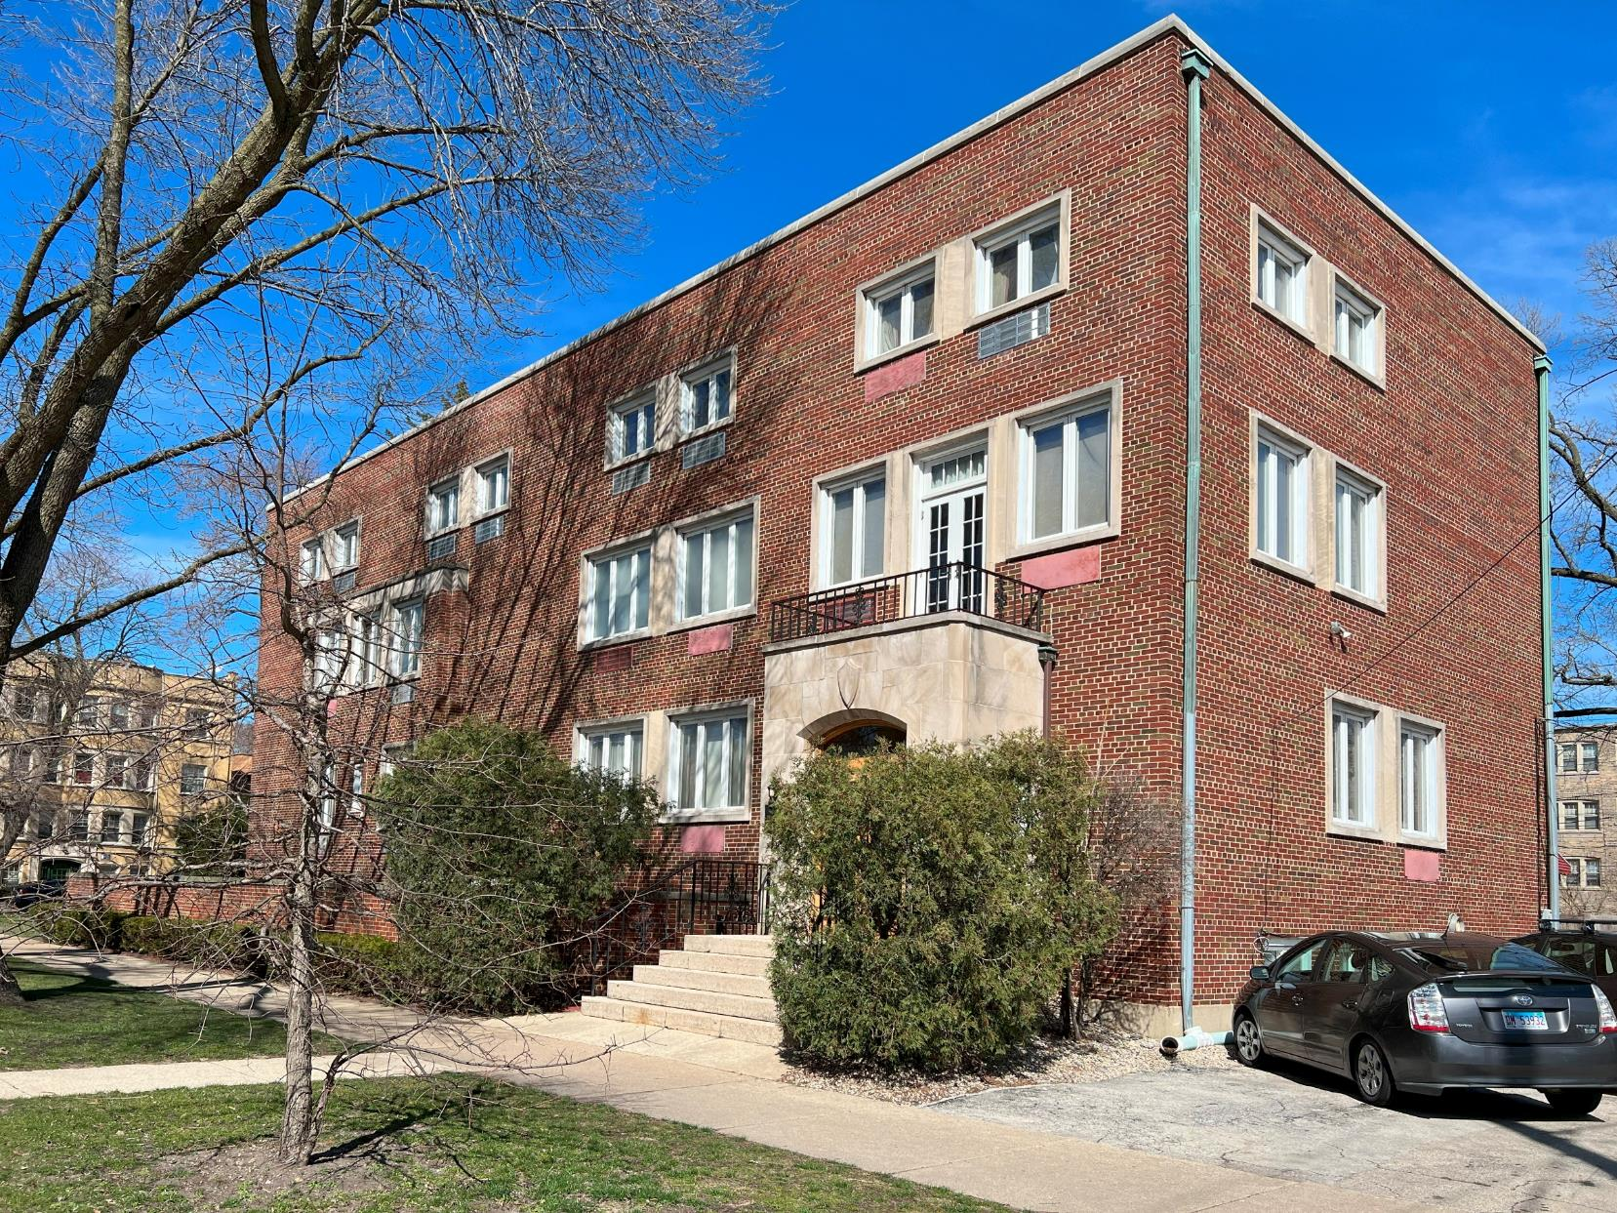
Existing Building
Existing Site Conditions
Building constructed 1964-65
Masonry and Steel Structure.
Existing Entrance off Greenview Ave.
Limited Space at the south end of the site. (3 Existing Parking Spaces)
Minimum Property Fencing.
Parking is open to the sidewalk.
Bulk of Construction is Interior Renovation.
Most of the exterior work will be done at the south end of the site.
All new exterior materials are planned to match the existing building.

Slide 4
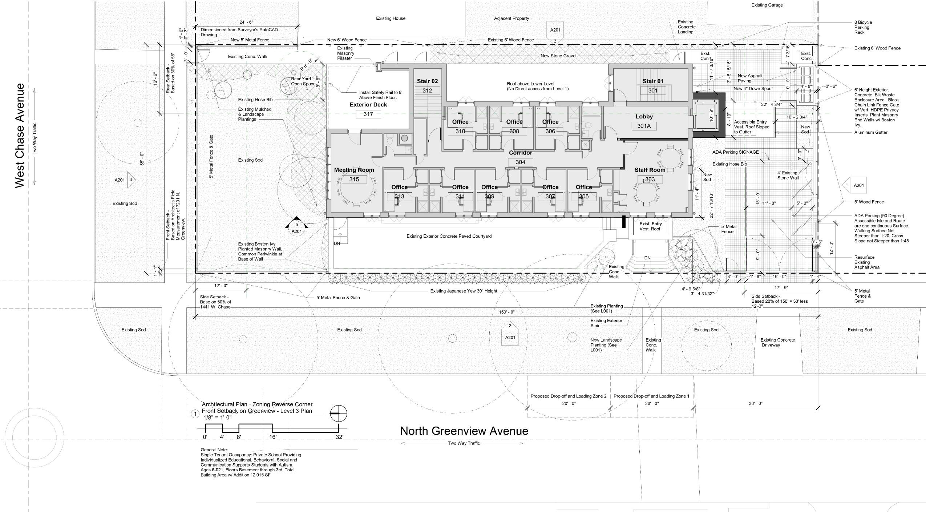
Proposed Site Plan

Slide 5
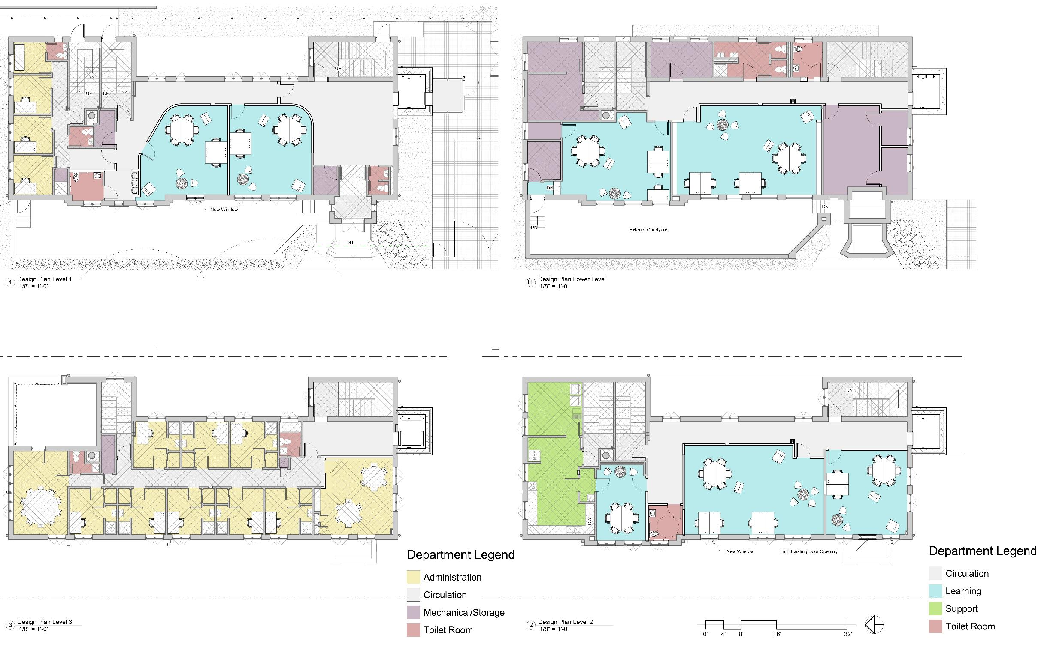
Proposed Floor Plans

Slide 6
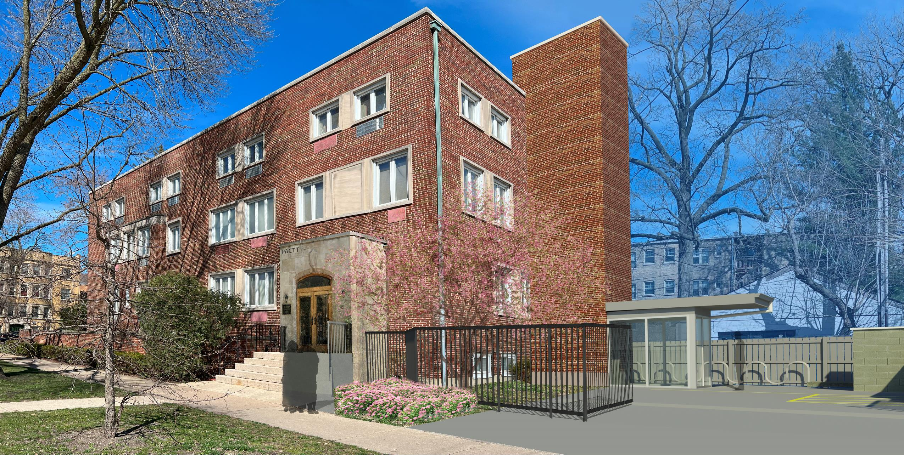
Proposed Renovation

